Slide 1

Let’s start with Allah Yaar
Bs in Computer Science

Slide 2
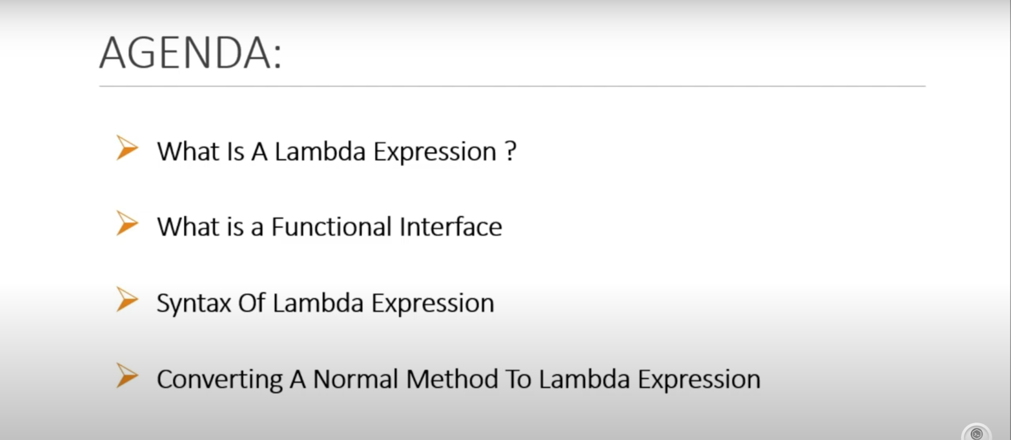
Lamda Expressein

Slide 3
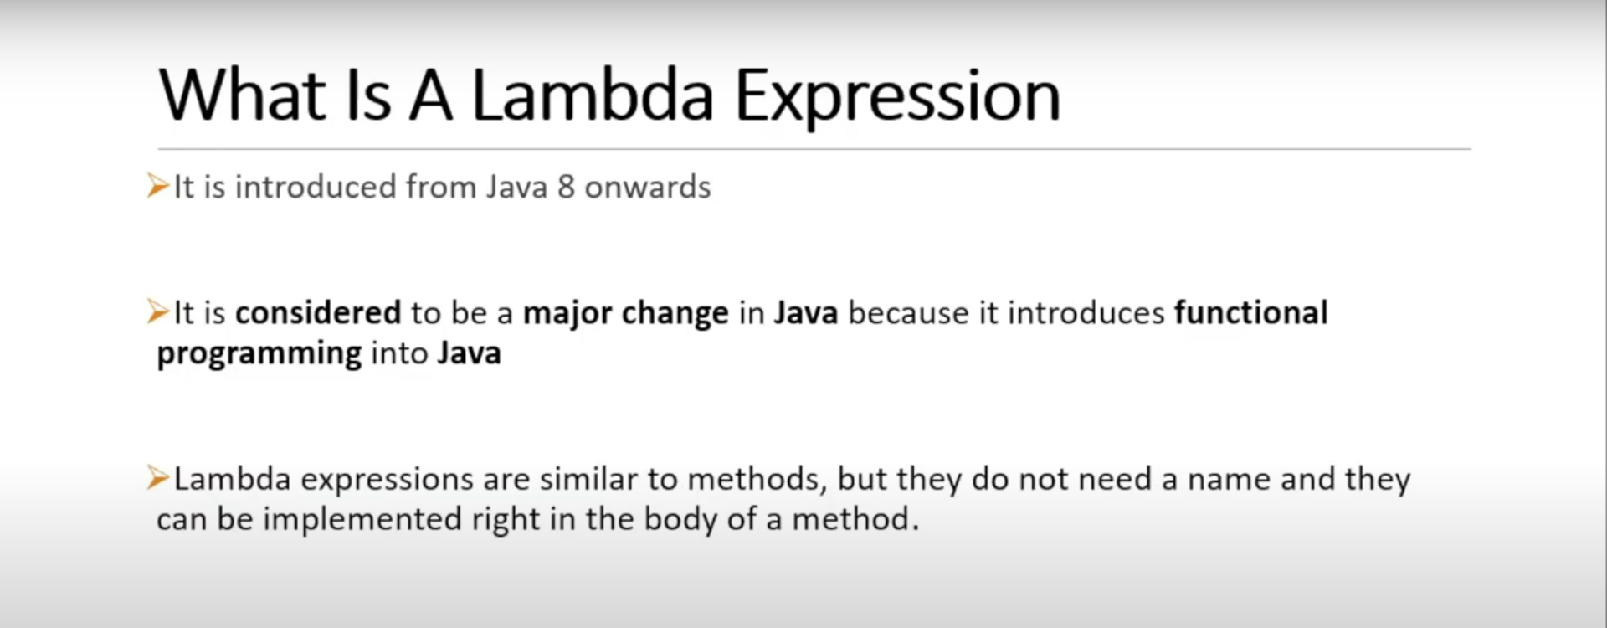
Lamda Expression

Slide 4
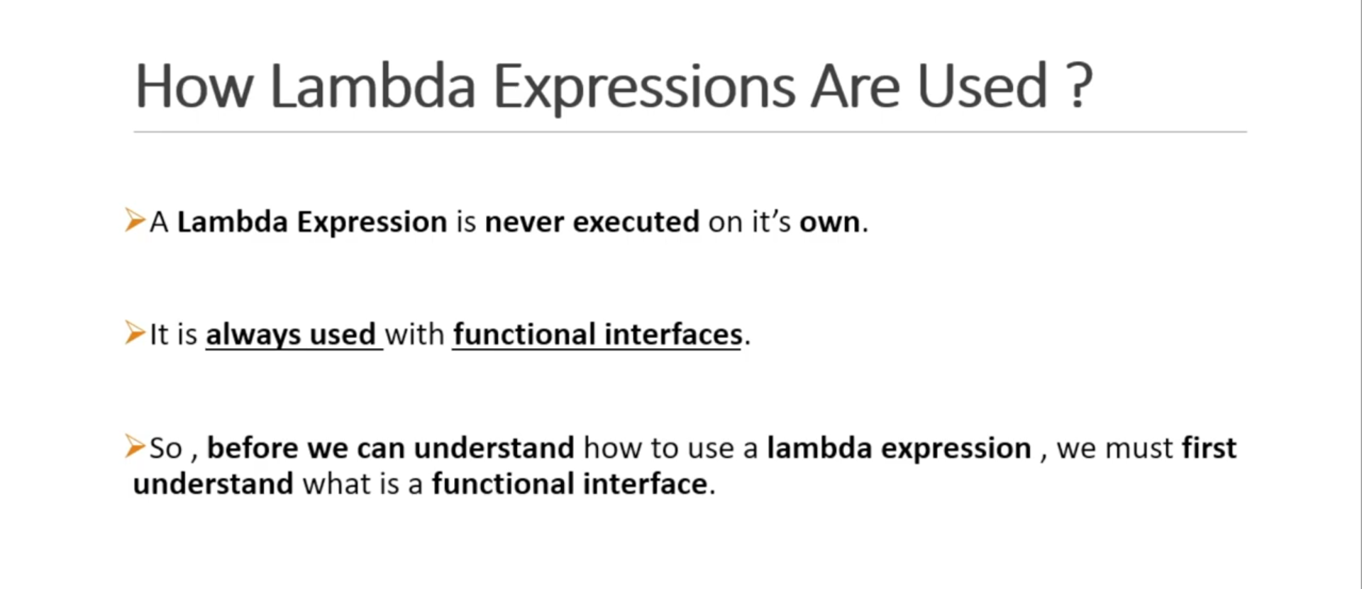
Lamda Expression

Slide 5
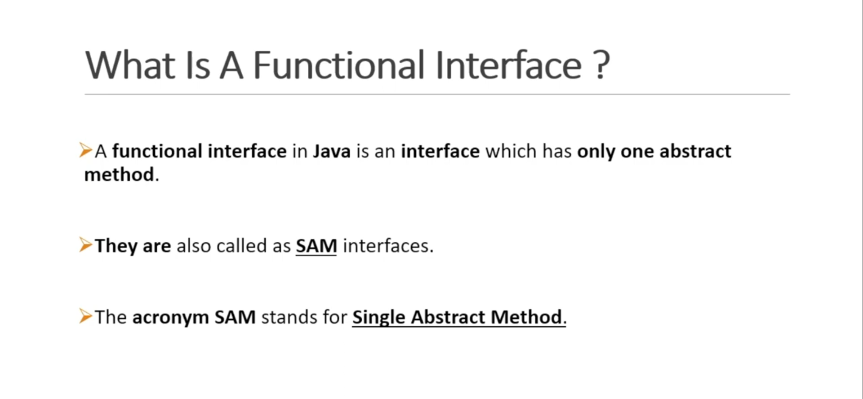
Lamda Expression

Slide 6
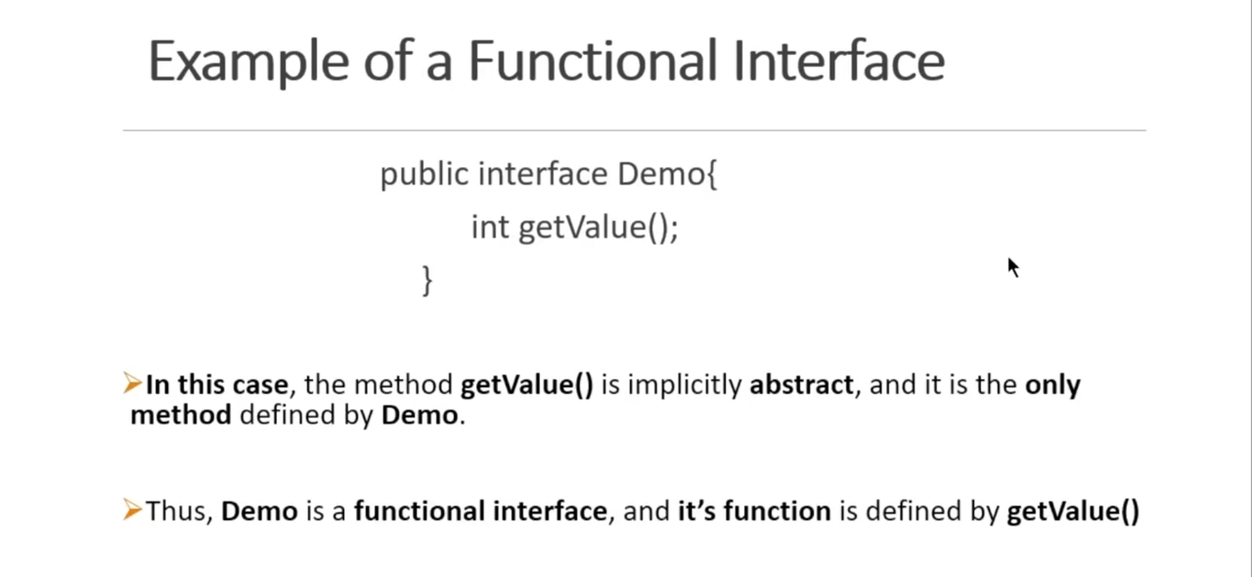
Lamda Expression

Slide 7
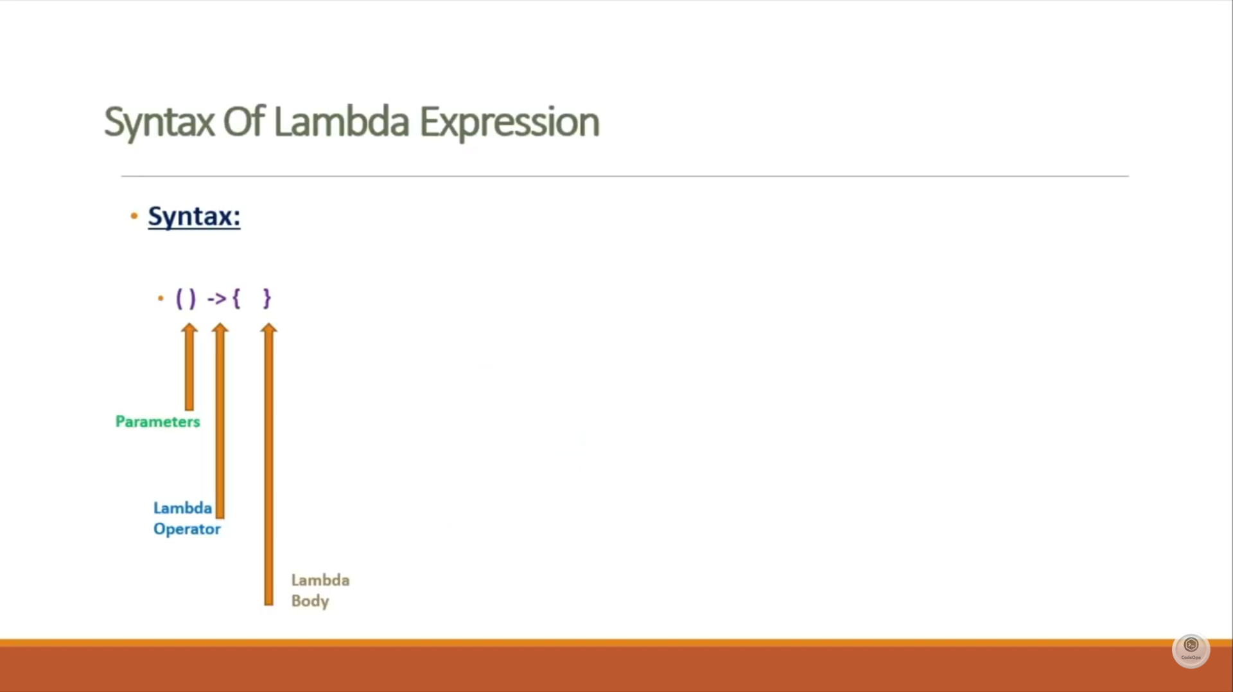
Lamda Expression

Slide 8
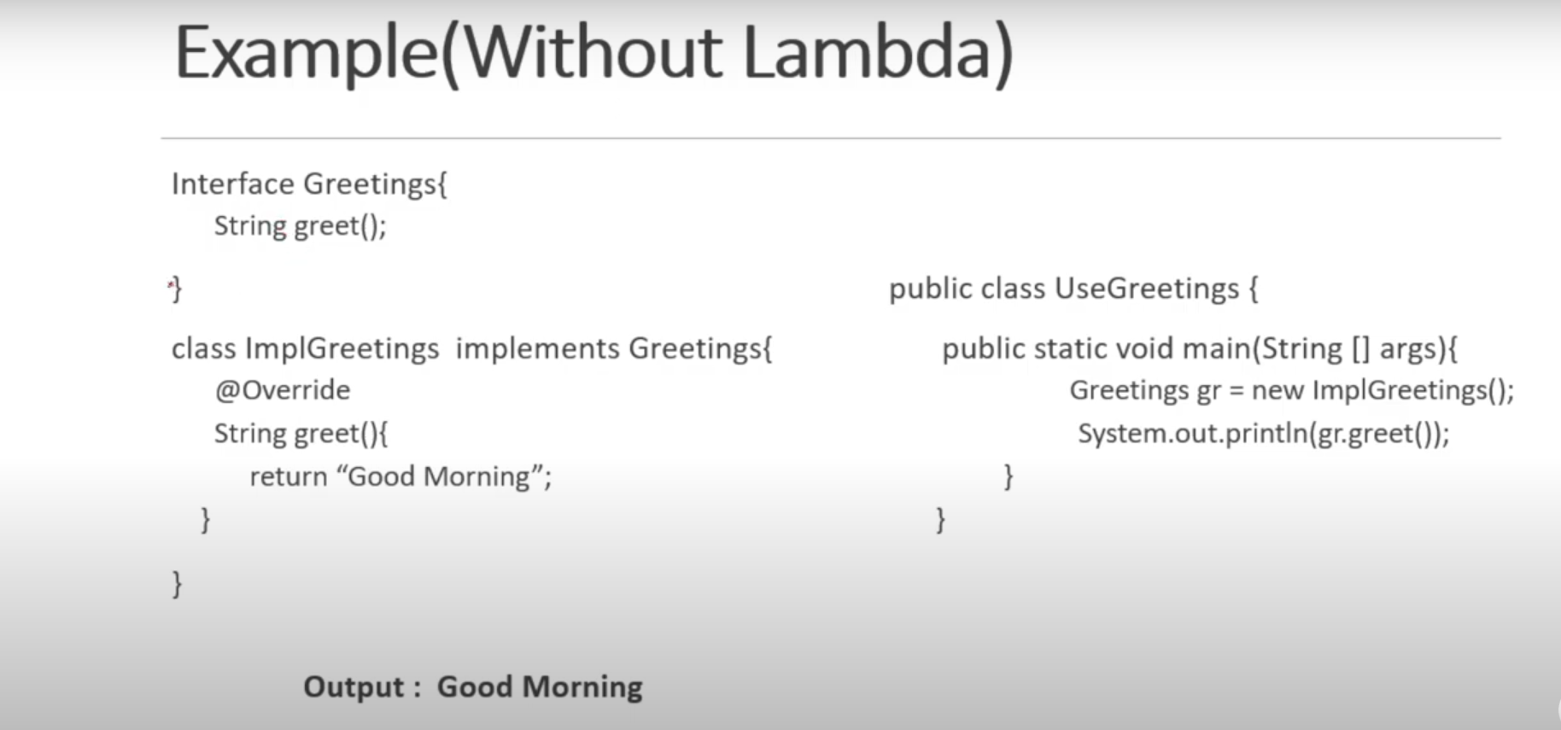
Lamda Expression

Slide 9
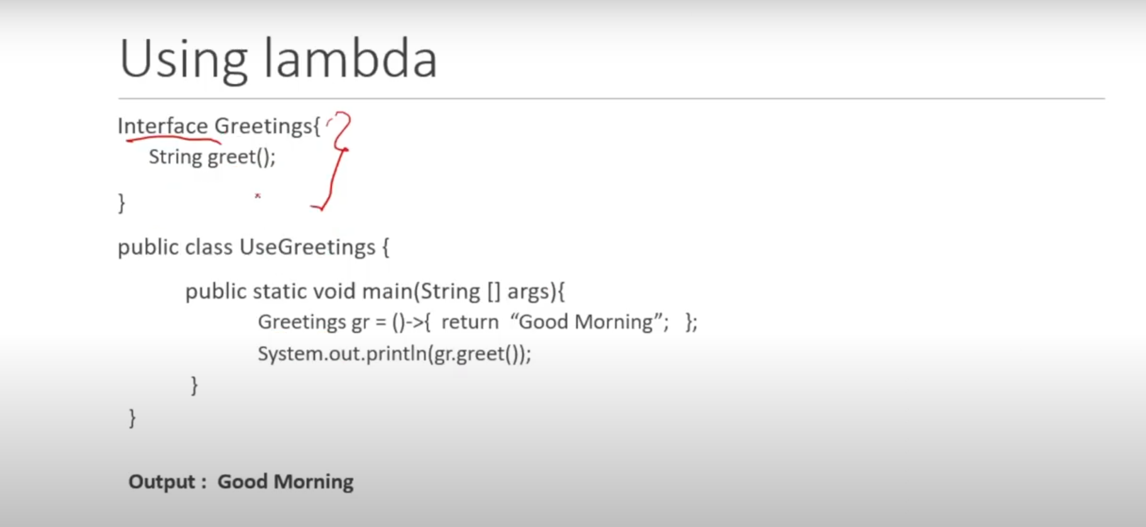
Lamda Expression

Slide 10
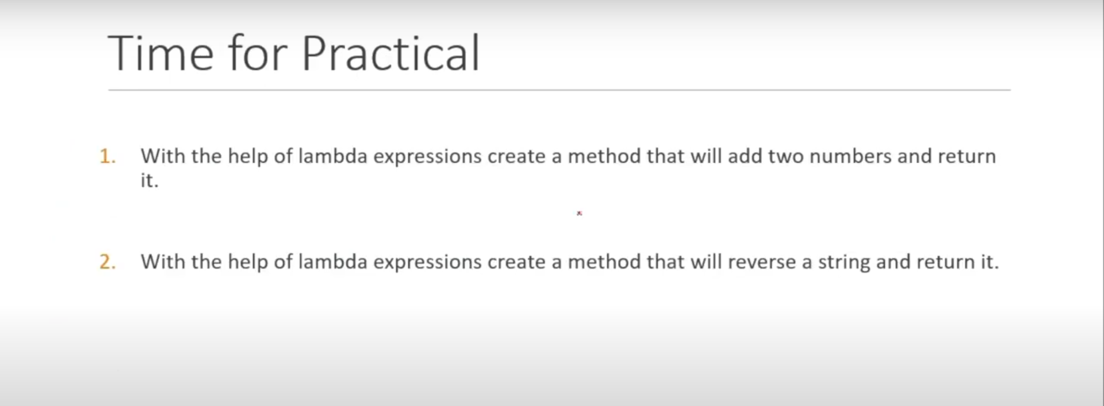
Lamda Expression

Slide 11
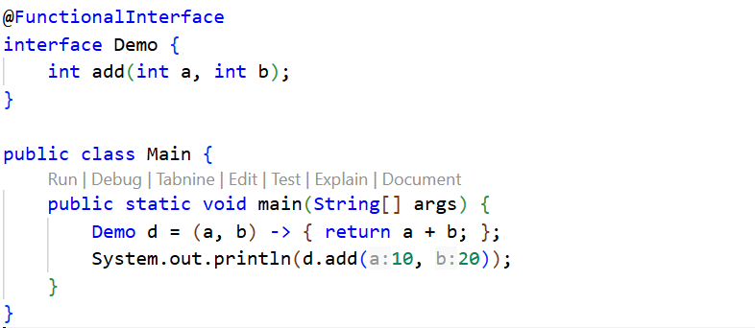
Lamda Expression

Slide 12
Thank you so much

